Slide 1
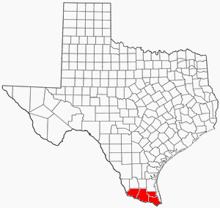
Irasema Garcia
Partnership Specialist
Rio Grande Valley
U.S. Census Bureau-Denver Region
(956) 572-1009
irasema.garcia@2020census.gov

Slide 2
Why We Do a Census?
Article 1, Section 2 of the US Constitution
The actual enumeration shall be made within three years after the first meeting of the Congress of the United States, and within every subsequent term of ten years, in such manner as they shall by law direct.

Slide 3
The Decennial Census
Conduct a census of Population and Housing disseminate results to the President, The States and The American People
Uses of Census data:
Apportion representation among states
Draw congressional and state legislative districts, school districts and voting precincts
Enforce voting rights and civil rights legislation
Distribute federal dollars to states
Inform planning decisions of federal, tribal, state and local government
Inform organizational decisions (e.g., where to locate, size of market, etc.) of businesses and non-profits

Slide 4
Funding
$675 Billion
Federal Funding
Annually

Slide 5
Largest Programs Using Census Bureau Data to Distribute Funds
Program Name | Federal Executive Department or Agency | Fiscal Year 2015 Funds
Medical Assistance Program | HHS | $311,805,244,413
SNAP | USDA | $71,035,786,000
Medicare Part B Physicians Fee Schedule Services | HHS | $70,300,000,000
Highway Planning and Construction | DOT | $38,479,013,855
Federal Pell Grant Program | ED | $29,916,694,438
National School Lunch Program | USDA | $18,915,944,292
Temporary Assistance for Needy Families | HHS | $17,225,738,021

Slide 6
Program Name | Federal Executive Department or Agency | Fiscal Year 2015 Funds
Section 8 Housing Choice Voucher | HUD | $15,761,488,440
Title 1 Grants to Local Educational Agencies | ED | $14,253,154,251
Special Education Grants to States | ED | $11,382,885,850
Head Start | HHS | $8,538,887,781
Special Supplemental Nutrition Program for Women, Infants, and Children | USDA | $6,062,899,861
Federal Transit Formula Grants | DOT | $5,452,882,796
Foster Care Title IV-E | HHS | $5,409,221,818
Program Name | Federal Executive Department or Agency | Fiscal Year 2015 Funds
Child Care Mandatory and Matching Funds of the Child Care and Development Fund | HHS | $5,314,103,129
Section 8 Housing Assistance Payments Program | HUD | $4,367,081,456
State Children's Health Insurance Program | HHS | $4,212,457,713
School Breakfast Program | USDA | $4,057,189,000
Low-Income Home Energy Assistance | HHS | $3,387,315,199
Hurricane Sandy CDB Grant Disaster Recovery Grants | HUD | $3,347,522,549

Slide 7
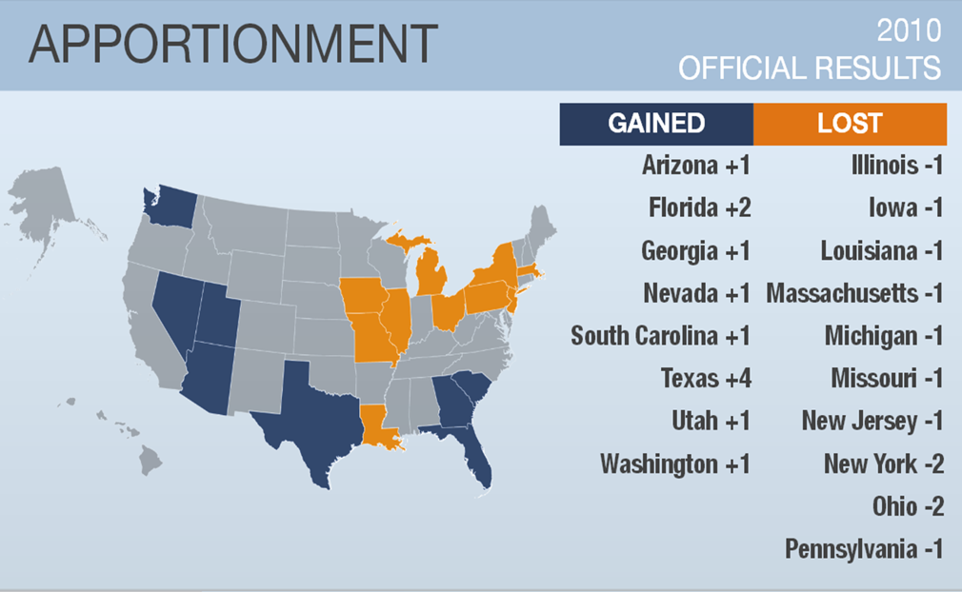
Representation

Slide 8
Confidentiality
The Census is confidential and required by Law
All responses to Census Bureau surveys and censuses are confidential and protected under Title 13 of the U.S. Code
The results from any census or survey are reported in statistical format only.

Slide 9
Confidentiality
Title 13, U.S. Code, all Census Bureau employees swear a lifetime oath to protect respondent data.
It is a felony for any Census Bureau employee to disclose any confidential census information during or after employment
Penalty for wrongful disclosure is up to 5 years imprisonment and/or a fine of $250,000.

Slide 10
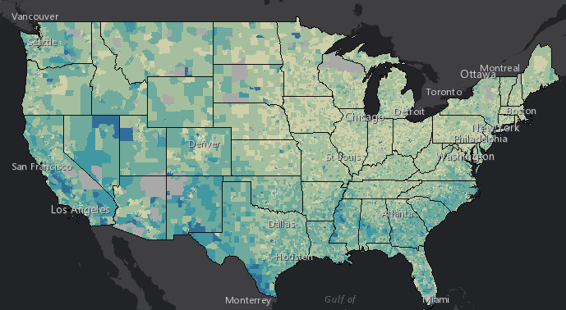

Slide 11
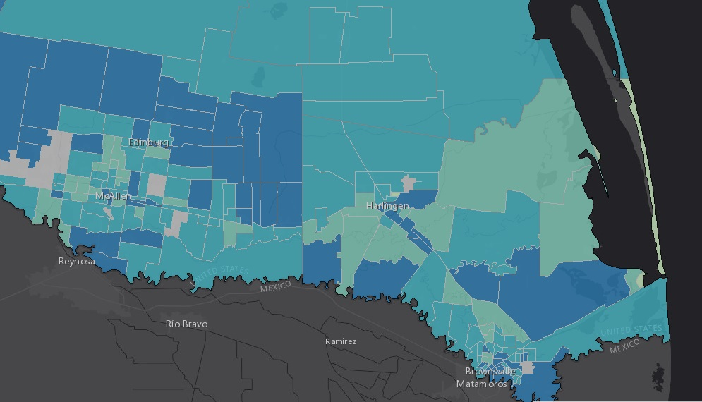

Slide 12
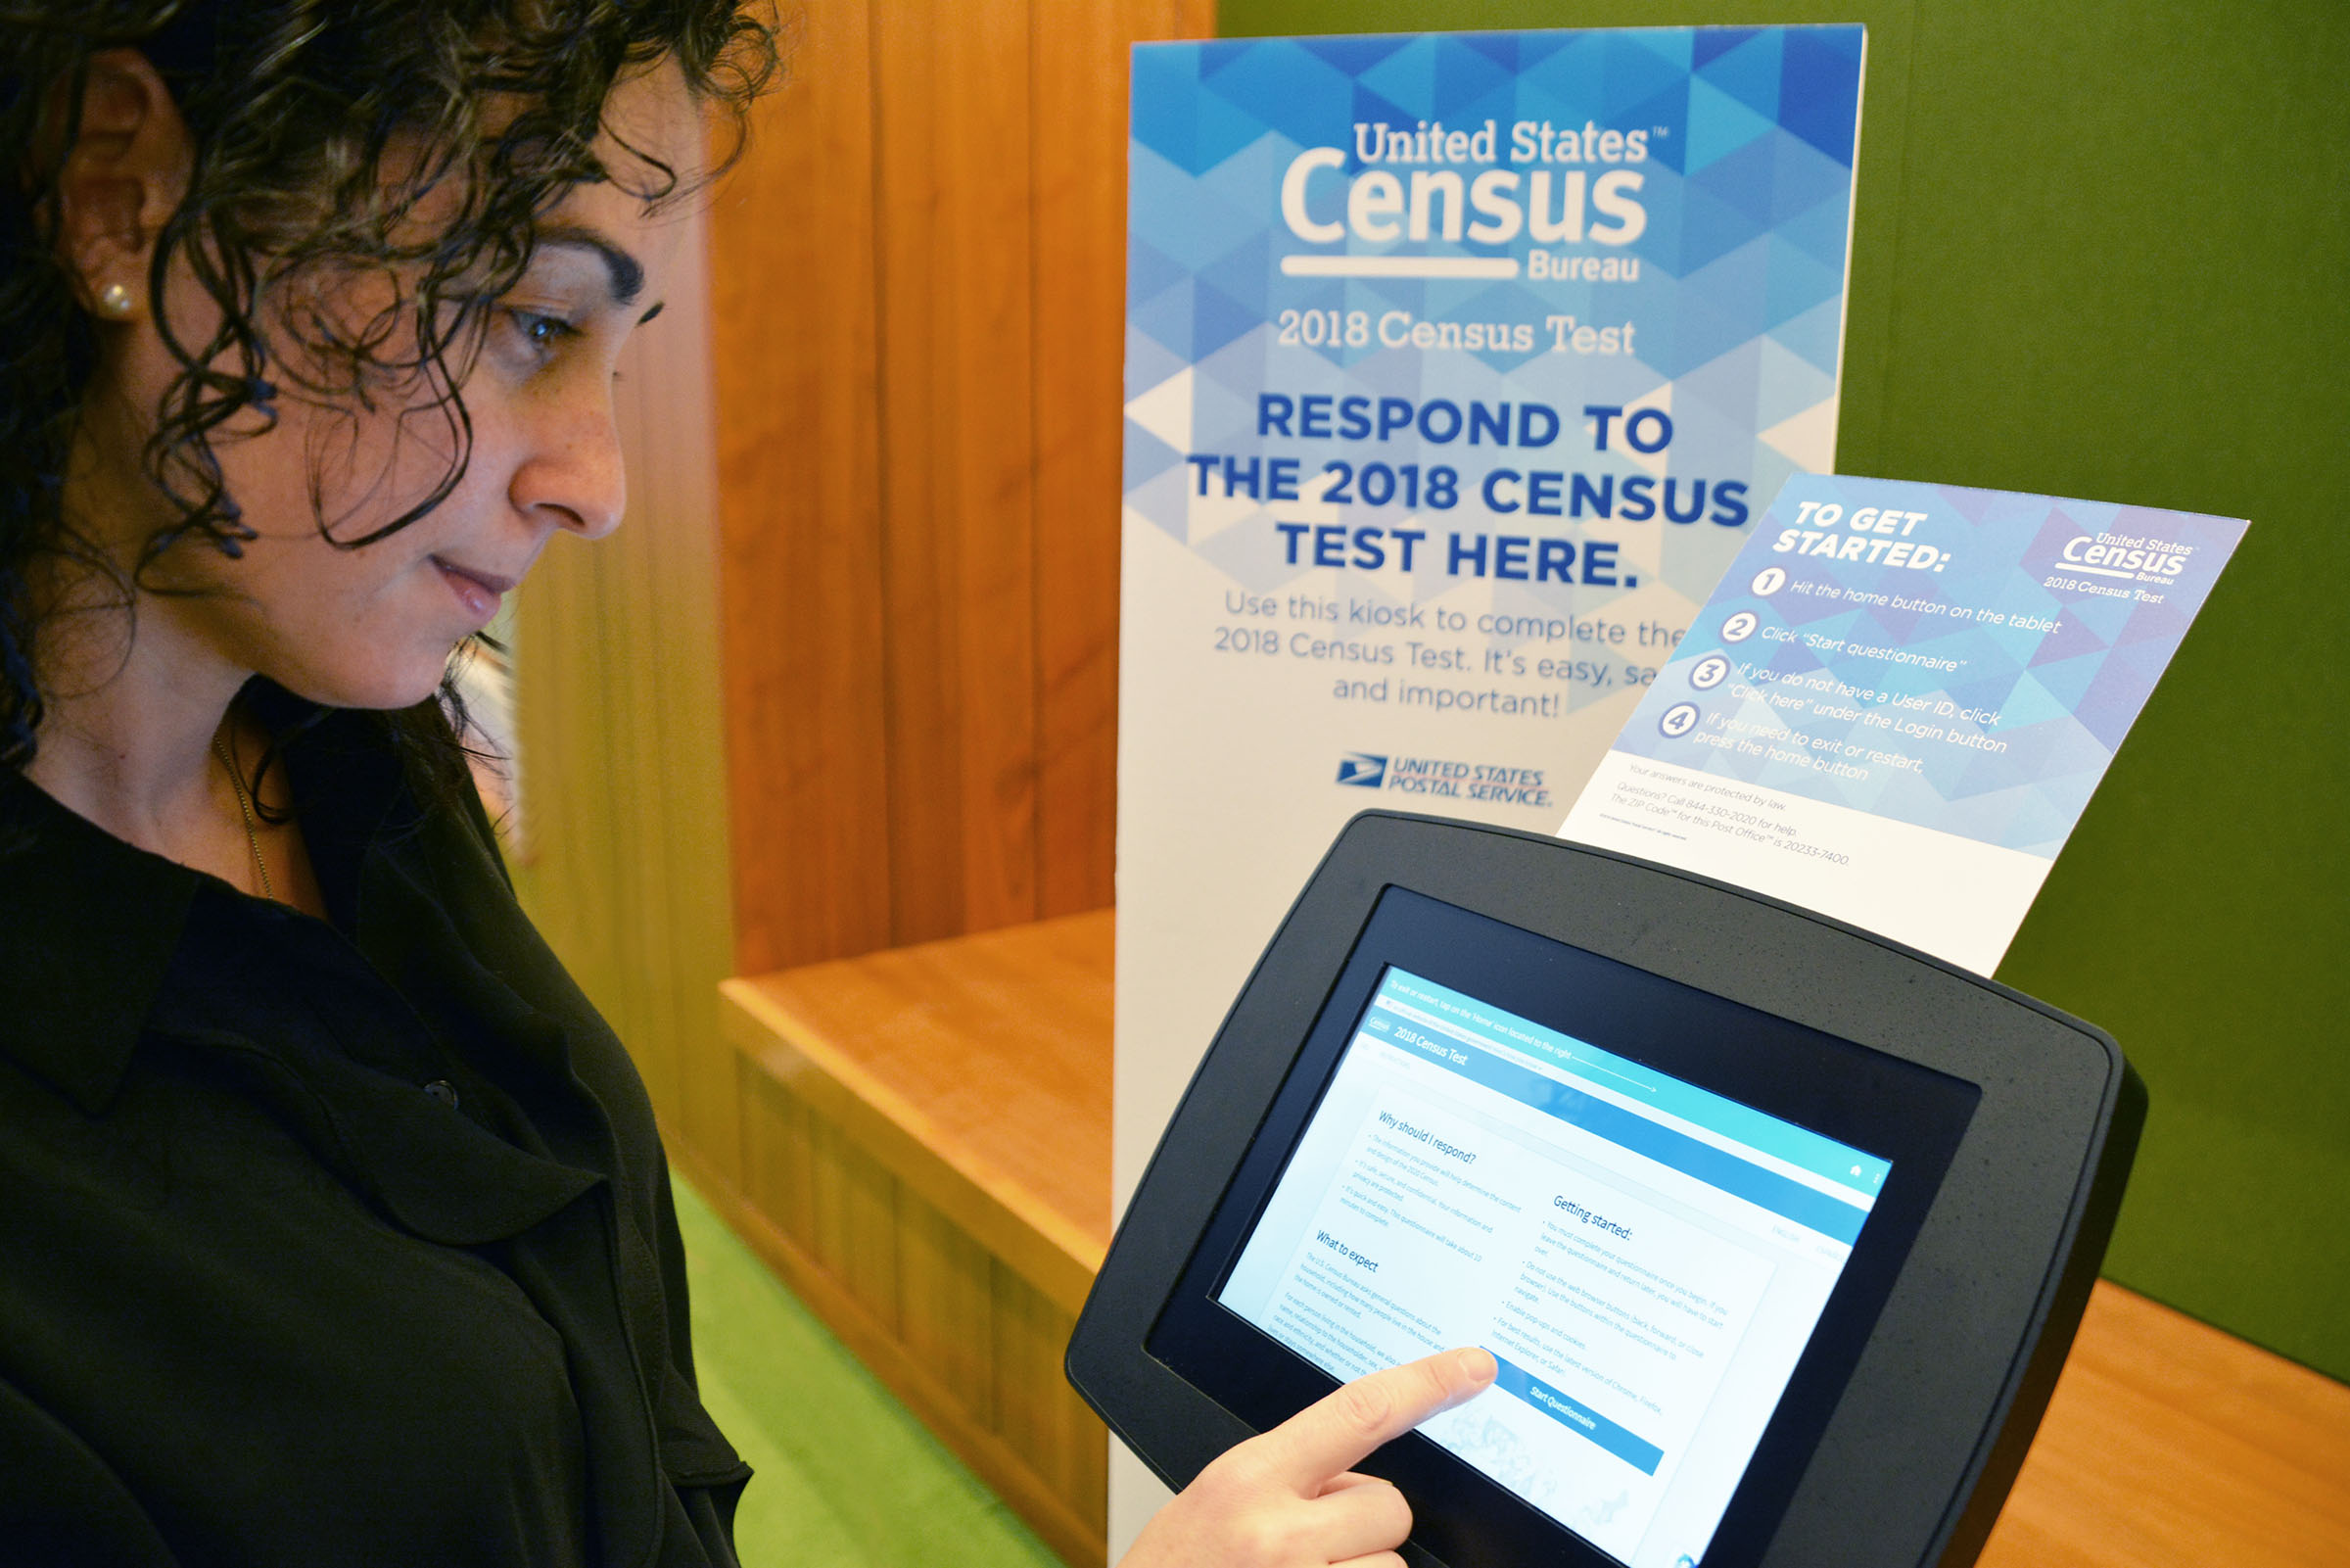
New Ability to Self Respond Starting March 12, 2020
Internet
Phone
Paper Form
Last day to respond - July 31, 2020
Notes:
OPTIMIZING SELF-RESPONSE.
In other words, how do we engage and motivate the public to respond?
The goal of optimizing self-response is to: generate the largest possible self-response, thereby reducing the number of households requiring follow-up.
We’re using technology a lot more in 2020 to make it easier for people to respond.
For the first time, you will be able to respond online, by phone and by mail.

Slide 13
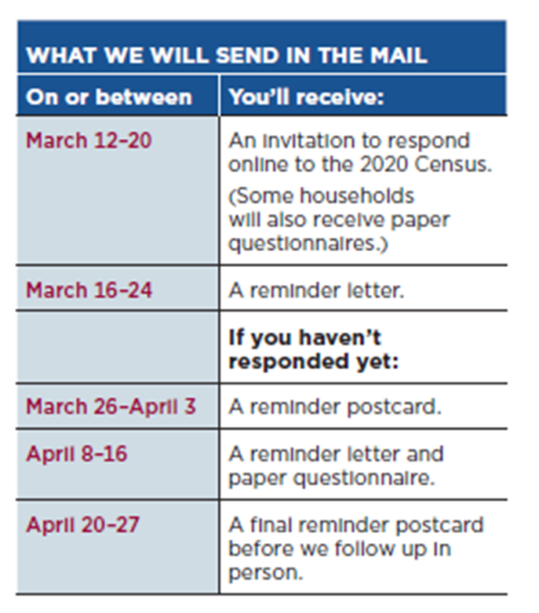
Invitation To Respond

Slide 14
How Can You Help?
Post Census informational flyers at all locations.
Disseminate information to employees
Invite Census to speak to staff/public

Slide 15
How Can You Help?
Share Census Information on Premise
Share digitally
Facebook
Twitter
Instagram
YouTube
LinkedIn
Website
Email Blast

Slide 16
How Can You Help?
Host Census Day Event: April 1, 2020
Be a Response Site
Computer
Tablet
Kiosk
Lab
Phone
Census Reminders
Bulletins
Mailers
News

Slide 17
How Can You Help?
Encourage Participation
Allow Census Presence at Events
Cobrand

Slide 18
CENSUS DAY 2020 – April 1, 2020
March 12- July 31

Slide 19
Statistics in Schools (SIS)
The Importance of SIS in 2020
Using Statistics in Schools (SIS) resources in your classroom during the 2019-2020 school year will support efforts to make sure EVERY child is counted in the 2020 Census. This count impacts the federal funds that communities receive for special education, classroom technology, teacher training, after-school programs, school lunch assistance, and more.

Slide 20
What is Statistics in Schools?
Statistics in Schools (SIS) is an education program fueled by the U.S. Census Bureau and created by teachers, for teachers.
The program leverages census data to create engaging, free, and easily downloadable classroom activities for students in grades pre-K through 12.
SIS is an ongoing program that teachers across the country have been using since 2014, and the 2020 Census-related materials will add to the more than 150 resources that are already available.

Slide 21
SIS and the 2020 Census
SIS plays a huge role in promoting the 2020 Census, relaying important messages through trusted voices in established school communities.
New SIS materials highlight the importance of everyone, especially children, being counted in the 2020 Census.
By educating students about the importance of being counted, we encourage them to share that message with an adult in their home who will complete the census.

Slide 22
Why the 2020 Census Matters to Schools
An accurate count of ALL children is critical for educators and their students because 2020 Census responses drive decisions about the distribution of federal funds for programs such as:
Special education
Free and reduced-price lunch
Class sizes
Classroom technology
Teacher training
After-school programs
Head Start
Playground and public parks
Public transportation

Slide 23
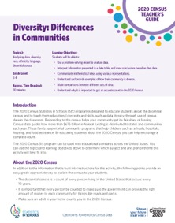
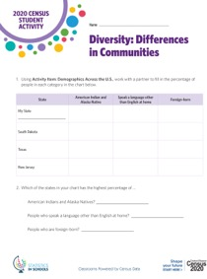
What’s in SIS?
67 new activities for grades pre-K through 12 that challenge students to use data in interactive ways to build skills in subjects such as history, math, geography, and English.
Large, colorful maps with fun, census-based facts about the country and its territories, including state-by-state comparisons.
A storybook with activities and a music video for children in preschool and early grades.
Engaging videos created specifically for elementary, middle, and high school grade bands.
Resources for English language learners and adult English as a second language students.

Slide 24
Resources for Every Age
English Language Learners (ELLs)
Pre-K
Elementary School
Middle School
Adult English as a Second Language (ESL)
High School

Slide 25
Why Should Schools Get Involved?
By using and promoting the SIS program, schools can:
Impact the amount of federal funding their school receives.
Impact student readiness for learning.
Enhance student learning across subjects.
Boost students’ statistical literacy and data-finding skills.
Prepare students for success in a data-driven world.
Encourage teachers to easily bolster their existing lesson plans.
Motivate parents to complete the 2020 Census questionnaire.

Slide 26
Statistics in Schools (SIS)
Click her for census.gov
Click here for Statistics in Schools

Slide 27
Resources
www.census.gov
Community Outreach Tool Kit
https://www.census.gov/partners/toolkit.pdf
2020 Census on Social Media-YouTube, Facebook, Twitter, Instagram, LinkedIn
Media Tool Kit

Slide 28
Thank You!
Irasema Garcia
Partnership Specialist
Rio Grande Valley
(956) 572-1009
irasema.garcia@2020census.gov

